Slide 1

GENPL (Gender Equality Network for Progress)
Garima, Nicole, Paola, Lucie
Week3_Team_1
Notes:
Garima, Paola, Lucie and myself, together we are GENPL a gender equality network for progress organization.

Slide 2
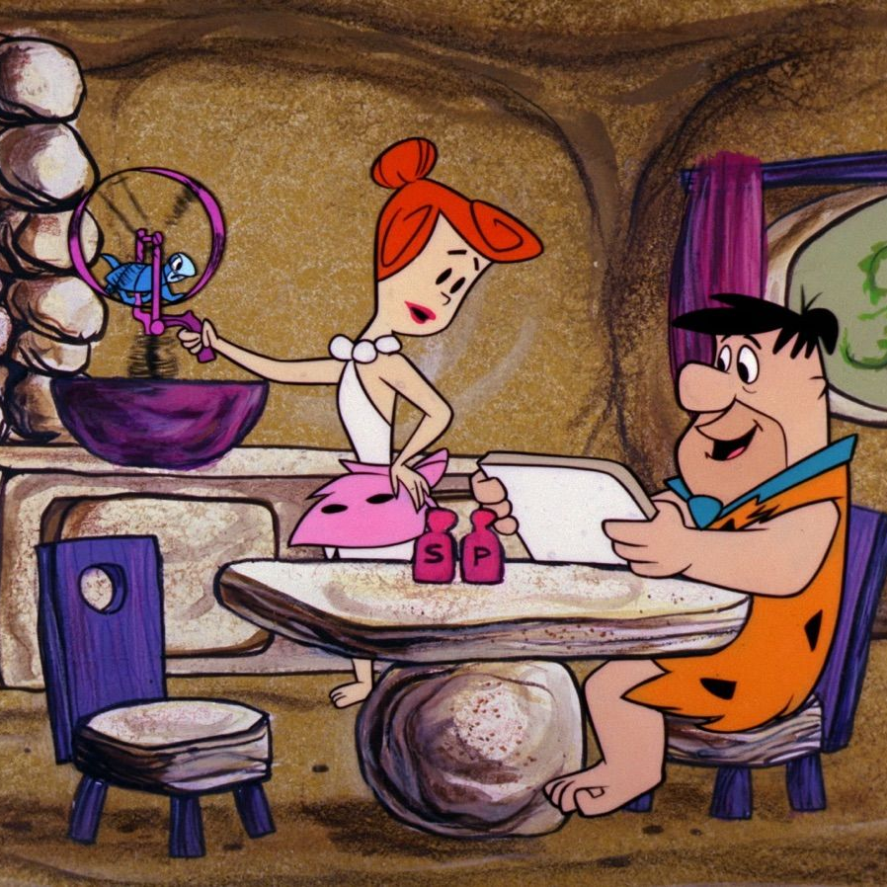
Outline
Project Overview
Data Wrangling and Cleaning
Exploratory Data Analysis
Teamwork & Project Management
Challenges
Conclusion
Links & References
Notes:
Historically, women were primarily seen as caregivers and homemakers, while men were the breadwinners. However, times have changed.
Today, women are strong, educated, and independent. Despite these advancements, gender inequality persists in the workplace.

Slide 3
Business Idea
"Driving GDP Growth Through Gender Equality"
Our services:
Workforce Analysis: Identify and address gender disparities in organizations.
Policy Development: Create policies that enhance gender equality.
Economic Impact Studies: Showcase the economic benefits of gender equality.
Advocacy Campaigns: Drive awareness and influence policy for gender equality.
Notes:
We are a consulting and advocacy firm dedicated to enhancing economic growth by tackling gender inequality in the workforce.
By closing the gender gap in employment, leadership, and pay, we help countries unlock their full economic potential, driving significant GDP growth.

Slide 4
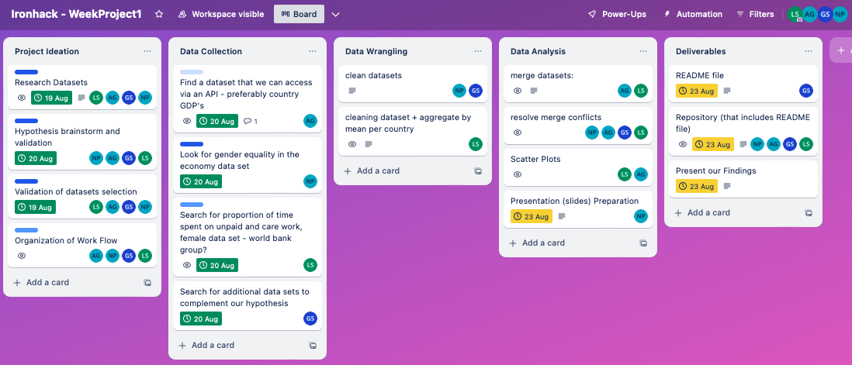
Project Overview – The Process
Notes:
Add Trello slide

Slide 5
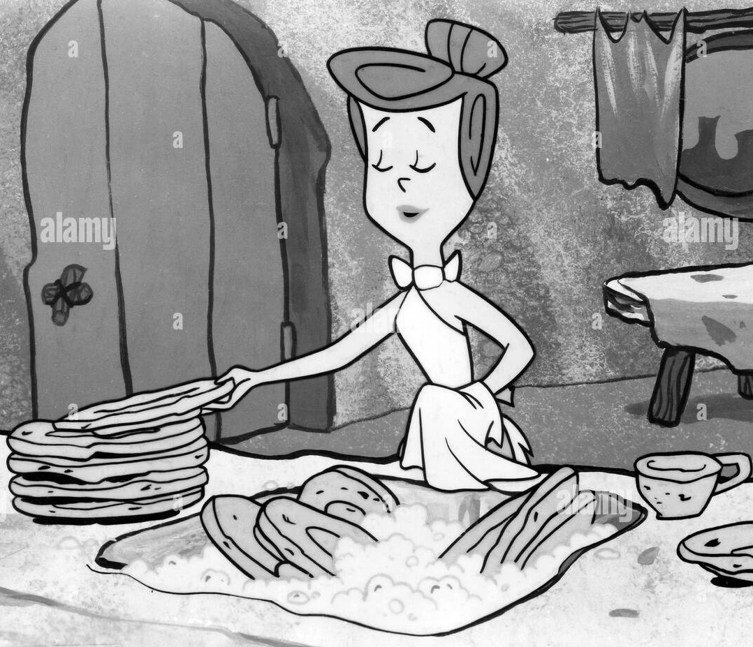




Hypothesis - Primary
“If women shift time from unpaid domestic work to paid employment, GDP will rise.”
Data Sets to Support:
.csv format
.xlsx format
.csv format
Website - API

Slide 6
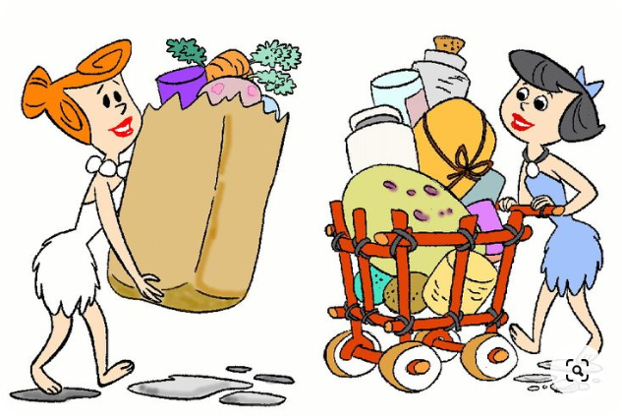
Hypothesis - Secondary
“Implementing and enforcing equal pay policies will reduce the gender pay gap.”
Increased household income
Boost consumption
Greater investment in education and health

Slide 7
Data Cleaning - The Process
We randomly picked 12 countries with a mix of GDP’s covering these regions:
Region | Europe | Americas | Asia Pacific | Africa
Countries | Norway | United States | Japan | Ghana
 | Greece | Brazil | New Zealand | Cameroon
 | France | Colombia | Pakistan
 | Germany

Slide 8
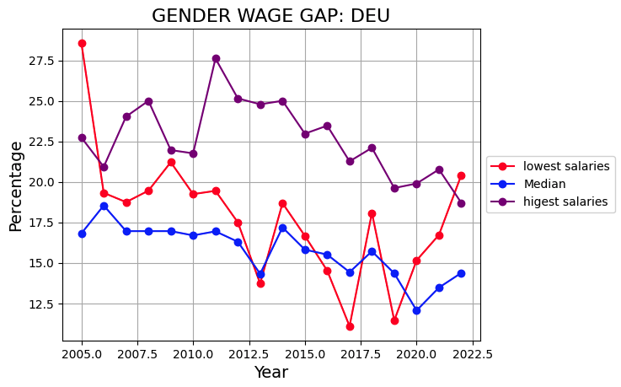
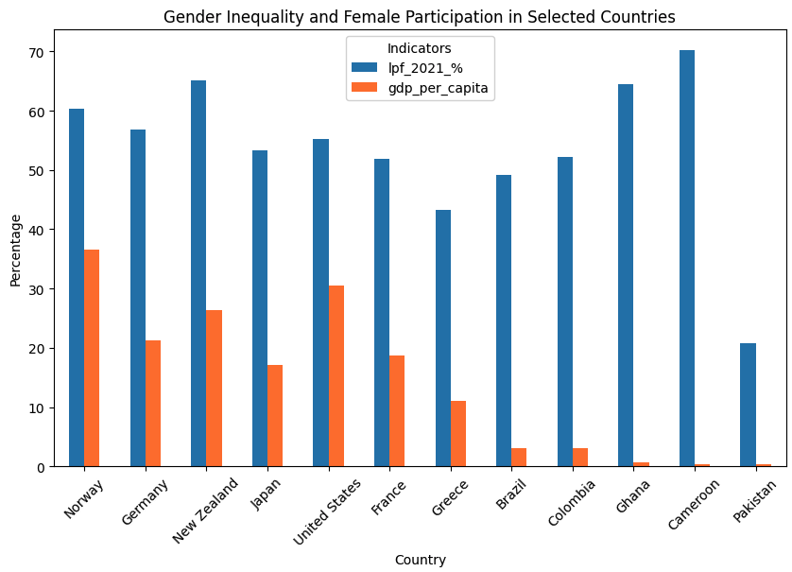
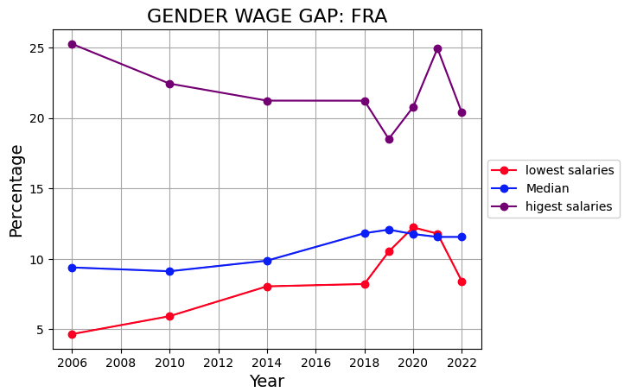
Our Findings - Current Status

Slide 9
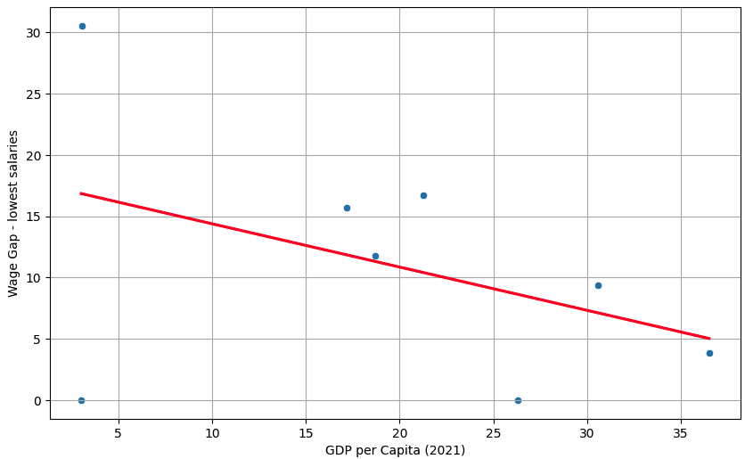
Our Findings & Analysis
The correlation between GDP per capita and wage-gap is -0.41. However, we can see that countries with highest GDP have lower wage-gap.

Slide 10
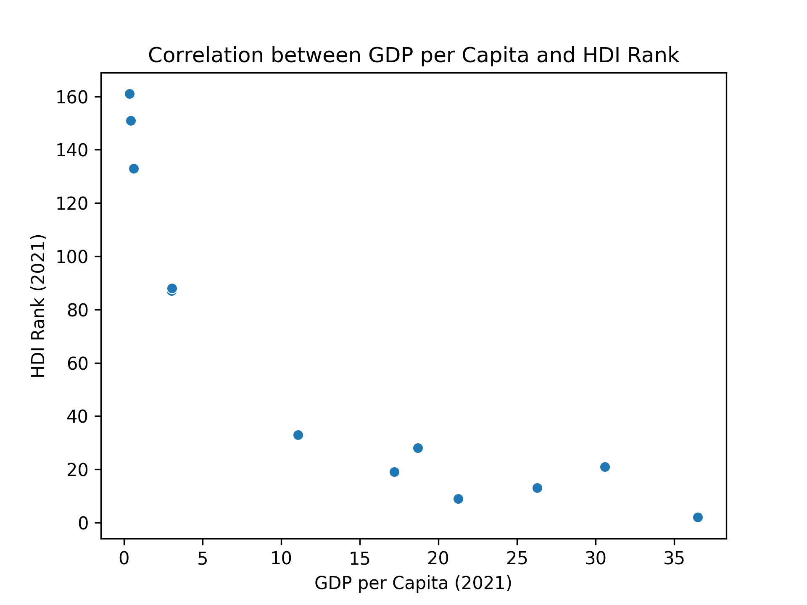
Our Findings & Analysis
For the year 2021, there is a strong exponential correlation (-0.87) between a country's GDP per capita and its HDI (Human Development Index) rank.
The higher the HDI Rank, the lower the GDP per capita.
Notes:
HDI (Human Development Index) is a composite index that measures a country's average achievements in three basic aspects of human development: health (life expectancy), education (mean years of schooling and expected years of schooling), and standard of living (GNI per capita).
this relationship indicates that higher levels of human development (better education, health, and standard of living) are often associated with higher economic prosperity, as measured by GDP per capita.

Slide 11
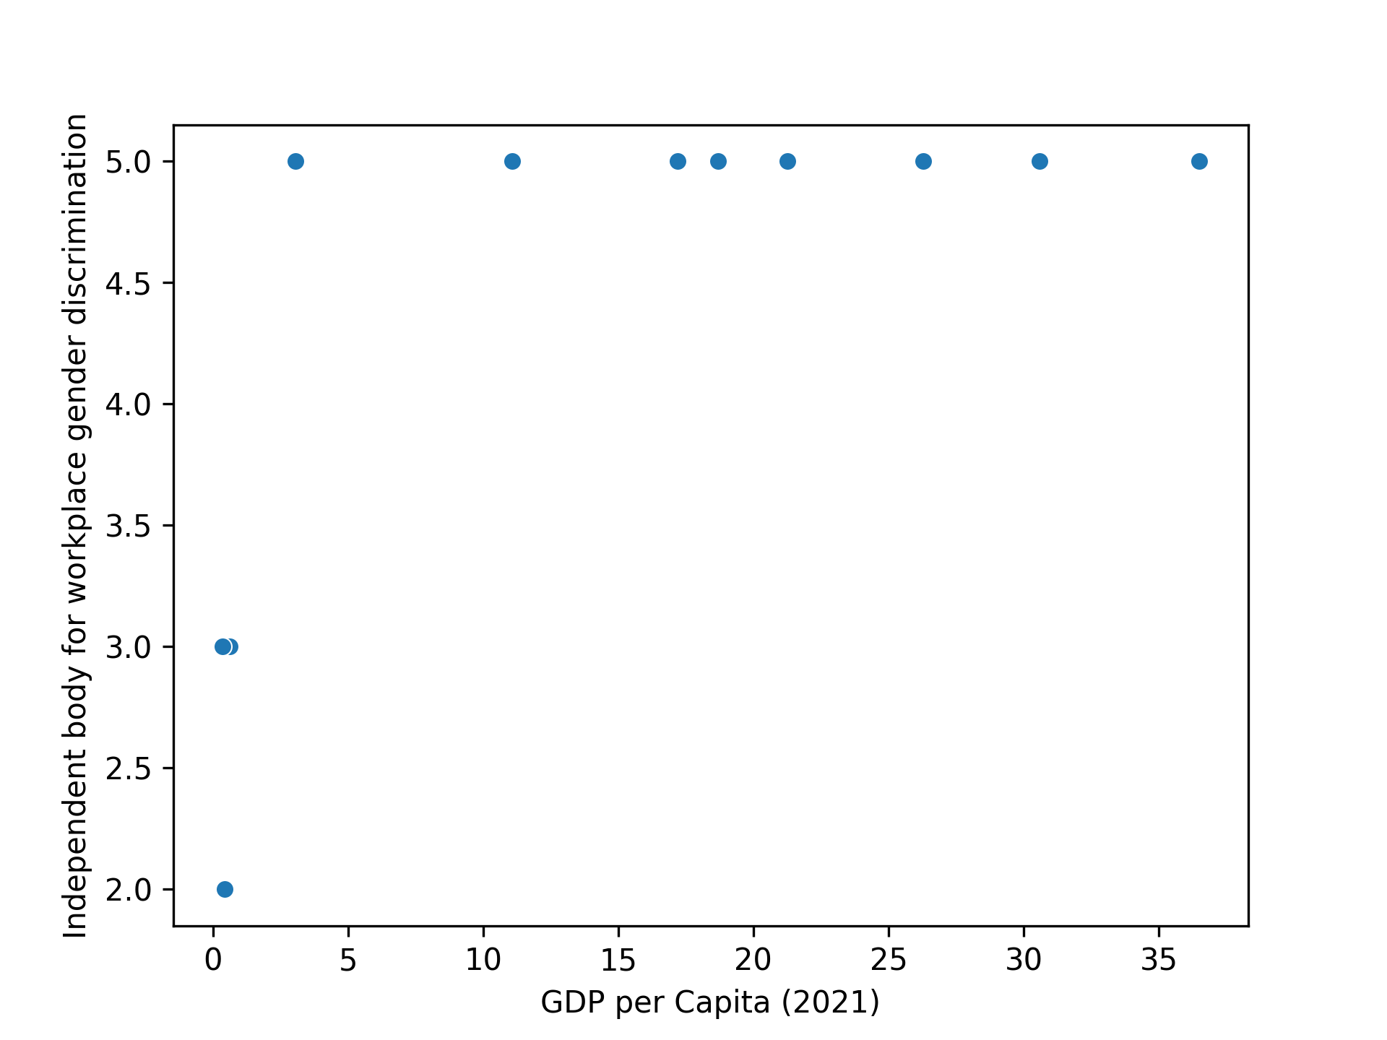
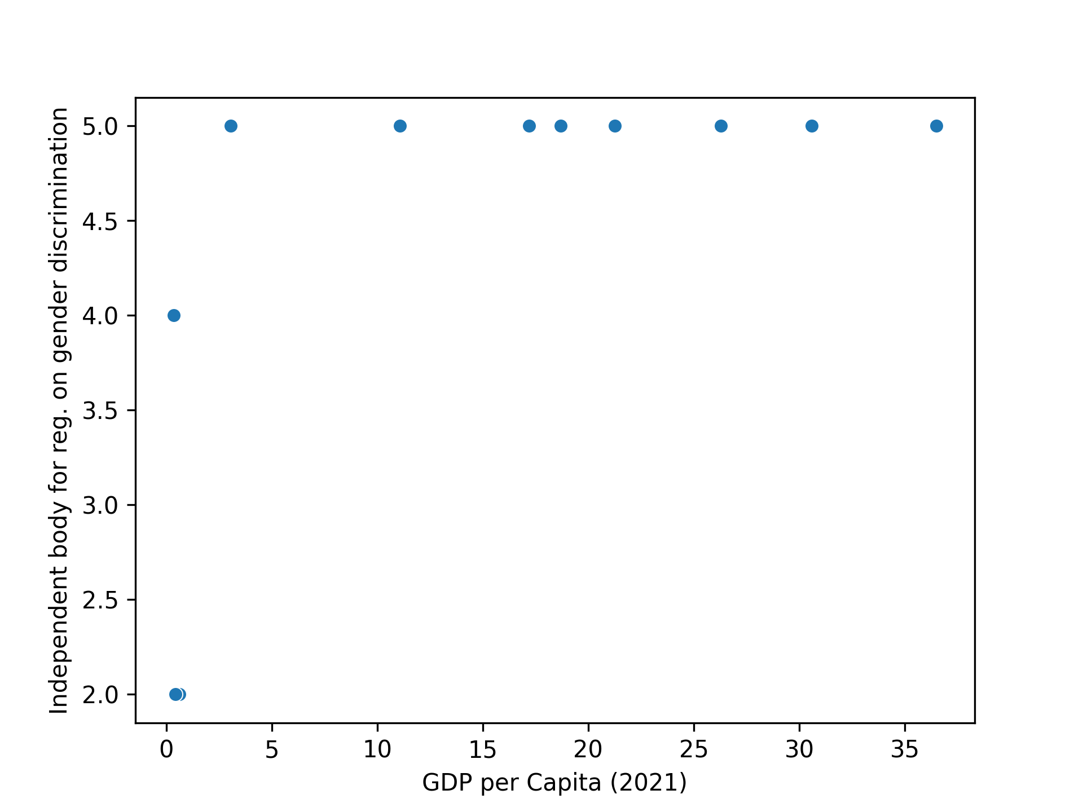
Our Findings & Analysis
In our subset, there is a strong correlation between GDP per Capita and the presence of an independent body preventing workplace gender discrimination through education awareness and advocacy, as well as with the presence of an independent body proposing regulations to prevent workplace gender discrimination. It seems, however, that the countries with a low GDP per Capita are outliers.
Notes:
independent body responsible for education, awareness, and advocacy to prevent workplace gender discrimination
independent body responsible for proposing legislation or policies to prevent workplace gender discrimination?

Slide 12
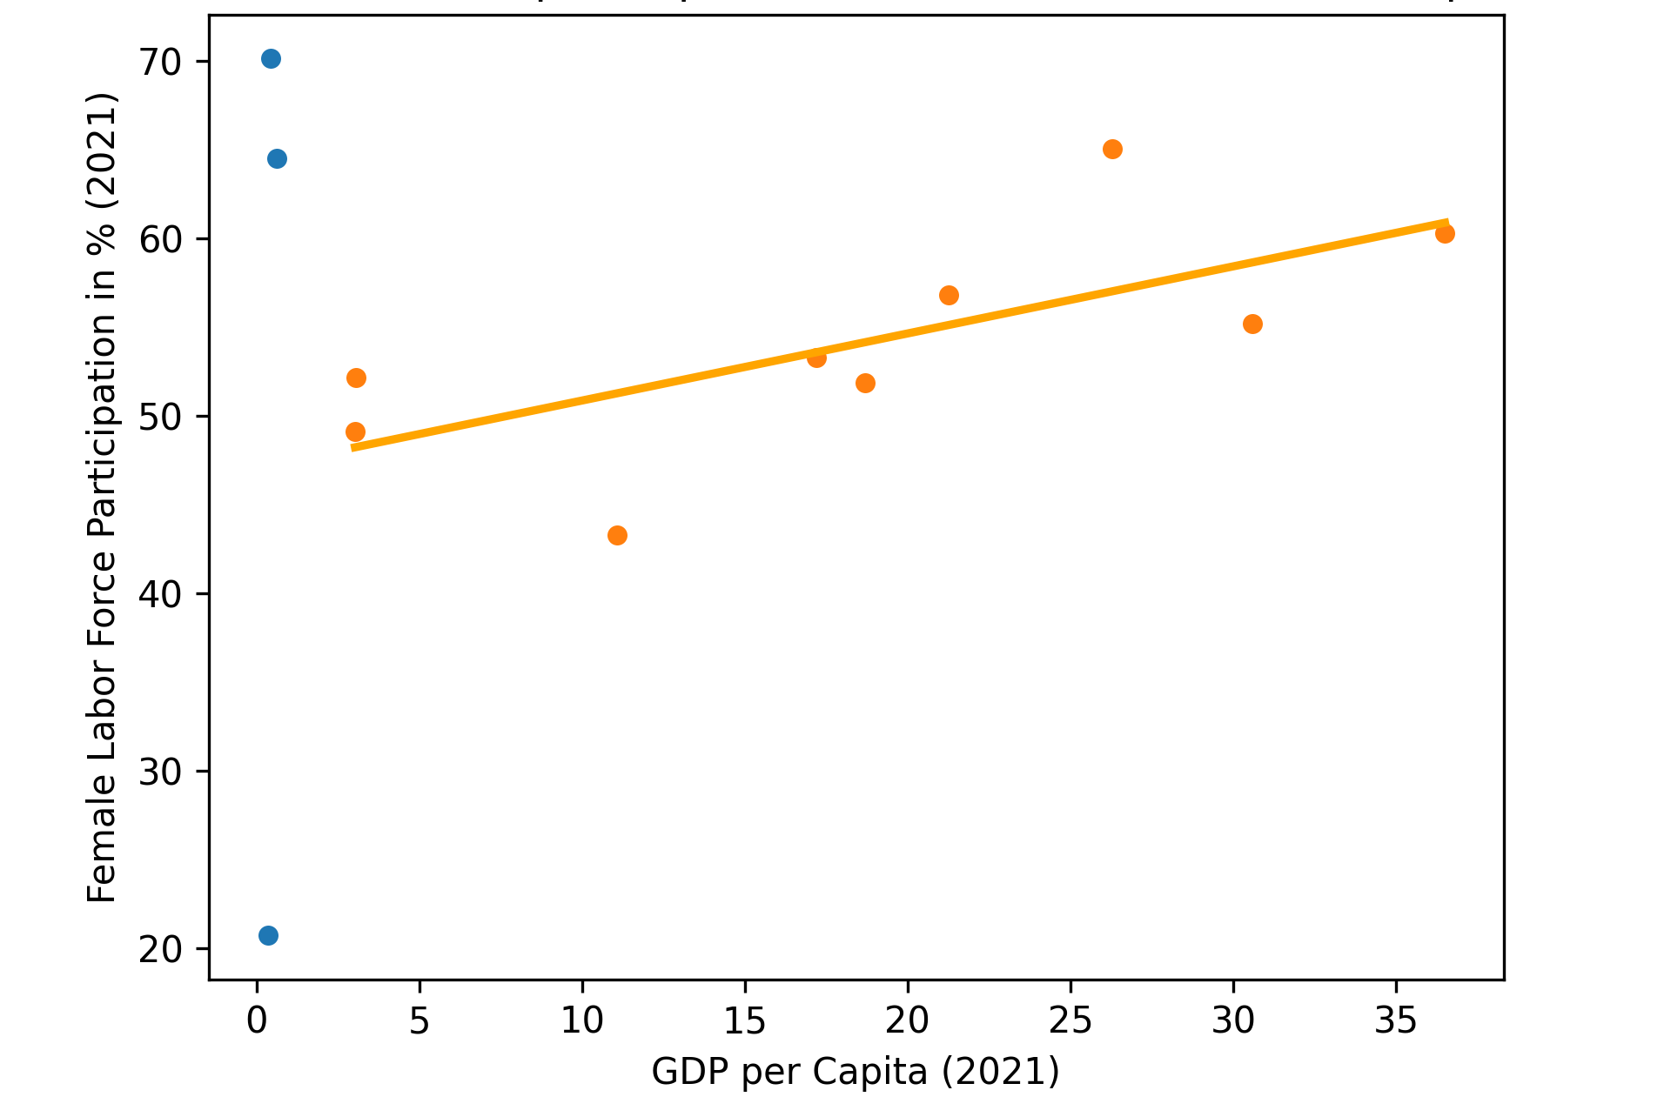

Our Findings & Analysis
In our subset, the correlation between GDP per capita and female labor force participation is 0.28.
However, we can see that countries with low GDP are outliers. When removing them, the correlation increases.
For countries with a GDP per capita higher than 3K USD, if the participation of women work force increases, then the GDP will increase.

Slide 13
Challenges
Raw datafile had metadata/explanations in the first 5 rows, which made the file irregular and caused an error (An error occurred: Error tokenizing data. C error: Expected 3 fields in line 5, saw 69) during the import.
Pandas couldn't read the excel format, so we had to download openpyxl library.
Inconsistency in the names of data frames and other variables in our different notebook’s branches so when we merged files, we had to redefine them.
GitHub technical challenges with the merges, especially when a collaborator imported an additional library for the purpose of their specific analysis.

Slide 14
Summary
The analysis shows that enhancing gender equality can unlock significant economic potential, driving more sustainable and inclusive growth in countries.
Next Steps
Expand Data Collection
Develop Predictive Models
Policy Impact Assessment

Slide 15
Links & References
Gender Equality in the Economy Data Download https://www.worldpolicycenter.org/maps-data/data-download/gender-equality-in-the-economy-data-download
Proportion of time spent on unpaid domestic and care work, female (% of 24 hour day) https://data.worldbank.org/indicator/SG.TIM.UWRK.FE?_gl=1%2Avv92k0%2A_gcl_au%2AMTY0MDA2MzY5LjE3MjQwNjIwNjE.&most_recent_year_desc=false&year=2018
Labour Force Participation Rate Global Perspectives: Contrasting LFPR Across Regions - Male and Female https://www.kaggle.com/datasets/iamsouravbanerjee/labour-force-participation-rate
Gender wage gap https://data-explorer.oecd.org/vis?tm=wage%20gaps&pg=0&snb=6&df[ds]=dsDisseminateFinalDMZ&df[id]=DSD_EARNINGS%40GENDER_WAGE_GAP&df[ag]=OECD.ELS.SAE&df[vs]=1.0&dq=......&pd=%2C&to[TIME_PERIOD]=false&vw=tl&lb=bt
Trello https://trello.com/b/eebDfI0x/ironhack-weekproject1

Slide 16




THANK YOU
Nicole Pinto
Garima Sharma
Paola Garay
Lucie Stenger

